Slide 1
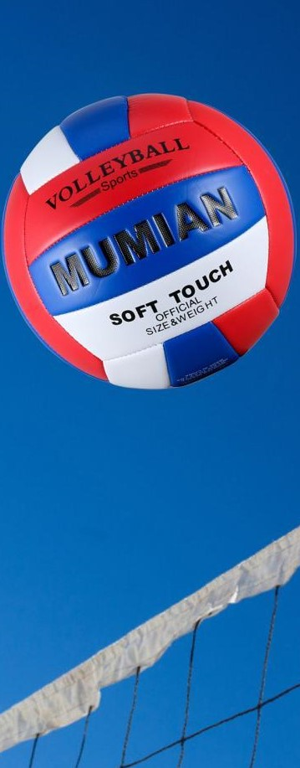
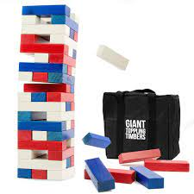
Westside High School
Week At a Glance (WAG)

Slide 2
Coach Thomas
Rec. Games: August 29th -2nd

Slide 3
Monday - Agenda
22nd
Standard:
PERG.1 The physically educated student demonstrates competency in a variety of motor skills and movement patterns.
a. Demonstrates competence while performing skills in a variety of recreational game settings and activities
b. Performs skills at a level of competence, which contributes to health-related fitness.
c. Demonstrates proper warm-up and cool-down protocol associated with different life time
sport physical activities.
PERG.3 The physically educated student demonstrates knowledge and skills to help achieve
and maintain a health-enhancing level of physical activity and fitness.
a. Maintains or improves fitness level by using the results of the Georgia Fitness Assessment
to guide changes in a personal program of physical activity.
b. Uses technologies to assess, enhance, and maintain health-related and skill-related fitness.
c. Analyzes the relationship between physical activity and longevity.
Personal and Social Behavior, Rules, Safety, and Etiquette
Learning Target
I can explain the basic rules of Nuke ‘Em
Opening ( 10-15 mins)
10 minute Walk & Attendance
Work-session ( 20 - 25 mins)
Teacher will explain and demonstrate rules of Nuke ‘em
Students will demonstrate understanding of rules by participating in a game of Nuke ‘Em
Teacher will ask for suggested added or modified rules based on games played by students
Criteria for Success
Students demonstrate mastery through Nuke ‘Em game play
Closing ( 05 – 10 mins)
-locker room unlocked for 5 minutes
-students use remaining time to cool down & rehydrate if necessary

Slide 4
Tuesday - Agenda
23rd
Standard:
PERG.1 The physically educated student demonstrates competency in a variety of motor skills and movement patterns.
a. Demonstrates competence while performing skills in a variety of recreational game settings and activities
b. Performs skills at a level of competence, which contributes to health-related fitness.
c. Demonstrates proper warm-up and cool-down protocol associated with different life time
sport physical activities.
PERG.3 The physically educated student demonstrates knowledge and skills to help achieve
and maintain a health-enhancing level of physical activity and fitness.
a. Maintains or improves fitness level by using the results of the Georgia Fitness Assessment
to guide changes in a personal program of physical activity.
b. Uses technologies to assess, enhance, and maintain health-related and skill-related fitness.
c. Analyzes the relationship between physical activity and longevity.
Personal and Social Behavior, Rules, Safety, and Etiquette
Learning Target
I can explain the basic rules of “NUKE ‘EM
Opening ( 10-15 mins)
10 minute Walk & Attendance
Work-session ( 20 - 25 mins)
Criteria for Success
Locker rooms unlocked & students go to bleachers to track & record distance & heart rate (partner with someone near you during walk if you don’t have tracking device: post on canvas)-5 minutes then locked
Coach will review: Learning Target, Basic rules of Nuke em
Students will participate in game
Students can actively participate in a game of Nuke ‘Em with a clear understanding of the rules
Closing ( 05 – 10 mins)
Cool Down

Slide 5
Wednesday - Agenda
24th
Standard:
PERG.1 The physically educated student demonstrates competency in a variety of motor skills and movement patterns.
a. Demonstrates competence while performing skills in a variety of recreational game settings and activities
b. Performs skills at a level of competence, which contributes to health-related fitness.
c. Demonstrates proper warm-up and cool-down protocol associated with different life time
sport physical activities.
PERG.3 The physically educated student demonstrates knowledge and skills to help achieve
and maintain a health-enhancing level of physical activity and fitness.
a. Maintains or improves fitness level by using the results of the Georgia Fitness Assessment
to guide changes in a personal program of physical activity.
b. Uses technologies to assess, enhance, and maintain health-related and skill-related fitness.
c. Analyzes the relationship between physical activity and longevity.
Personal and Social Behavior, Rules, Safety, and Etiquette
Learning Target
Students will be able to play a game of Nuke ‘Em and volleyball by following the rules
Opening ( 10-15 mins)
10 minute Walk & Attendance
Work-session ( 20 - 25 mins)
Locker rooms unlocked Students use knowledge from previous day to participate in game of Nuke em and volleyball
Students that want to play basketball can do so after 2 games of the previously mentioned
Criteria for Success
Students will participate in games of Nuke’ Em, volleyball, and/or basketball
Closing ( 05 – 10 mins)
-locker room unlocked for 5 minutes
-students use remaining time to cool down & rehydrate if necessary

Slide 6
Thursday - Agenda
25th
Standard:
PERG.1 The physically educated student demonstrates competency in a variety of motor skills and movement patterns.
a. Demonstrates competence while performing skills in a variety of recreational game settings and activities
b. Performs skills at a level of competence, which contributes to health-related fitness.
c. Demonstrates proper warm-up and cool-down protocol associated with different life time
sport physical activities.
PERG.3 The physically educated student demonstrates knowledge and skills to help achieve
and maintain a health-enhancing level of physical activity and fitness.
a. Maintains or improves fitness level by using the results of the Georgia Fitness Assessment
to guide changes in a personal program of physical activity.
b. Uses technologies to assess, enhance, and maintain health-related and skill-related fitness.
c. Analyzes the relationship between physical activity and longevity.
Personal and Social Behavior, Rules, Safety, and Etiquette
Learning Target
I can demonstrate my mastery of this week’s learning targets
Opening ( 10-15 mins)
5 minute Walk & Attendance
Work-session ( 20 - 25 mins)
Same as previous day
Criteria for Success
Same as previous day
Closing ( 05 – 10 mins)
-locker room unlocked for 5 minutes
-students use remaining time to cool down & rehydrate if necessary

Slide 7
Friday - Agenda
26th
Standard:
PERG.1 The physically educated student demonstrates competency in a variety of motor skills and movement patterns.
a. Demonstrates competence while performing skills in a variety of recreational game settings and activities
b. Performs skills at a level of competence, which contributes to health-related fitness.
c. Demonstrates proper warm-up and cool-down protocol associated with different life time
sport physical activities.
PERG.3 The physically educated student demonstrates knowledge and skills to help achieve
and maintain a health-enhancing level of physical activity and fitness.
a. Maintains or improves fitness level by using the results of the Georgia Fitness Assessment
to guide changes in a personal program of physical activity.
b. Uses technologies to assess, enhance, and maintain health-related and skill-related fitness.
c. Analyzes the relationship between physical activity and longevity.
Personal and Social Behavior, Rules, Safety, and Etiquette
Learning Target
Freestyle Friday
Opening ( 10-15 mins)
Attendance
Work-session ( 20 - 25 mins)
Students are able to engage in various activities/sports typically those that they are most interested
Teacher will conference will students and possibly make parent phone calls/contact as needed
Criteria for Success
I can demonstrate my understanding of the rules, procedures, and expectations by following them during class time and asking questions to teacher if necessary.
Closing ( 05 – 10 mins)
N/A

Slide 8
Resources
https://www.nike.com/nrc-app

